Slide 1
Building Kubernetes From Source

Slide 2
Prerequisite
- An ubuntu server (version 18.04+)
- More than 4.5GB of memory (preferably 8GB+)
- 30GB of free space

Slide 3
Building K8s From Source - 1
- Install docker
sudo apt update
sudo apt install –y docker.io
sudo usermod –aG docker $USER
newgrp docker
- Install compilation and other tools
sudo apt install -y gcc make socat curl git

Slide 4
Building K8s From Source - 3
- Install go
curl –O https://dl.google.com/go/go1.13.4.linux-amd64.tar.gz
sudo tar –C /usr/local –xzf go1.13.4.linux-amd64.tar.gz
Add following line to $HOME/.profile:
export PATH=$PATH:/usr/local/go/bin
Then:
source $HOME/.profile

Slide 5
Building K8s From Source - 4
- Compile and run K8s
git clone --depth 1 https://github.com/kubernetes/kubernetes
cd kubernetes
export KUBERNETES_PROVIDER=local
hack/install-etcd.sh
Add etcd to PATH:
source $HOME/.profile
Add this line in $HOME/.profile

Slide 6
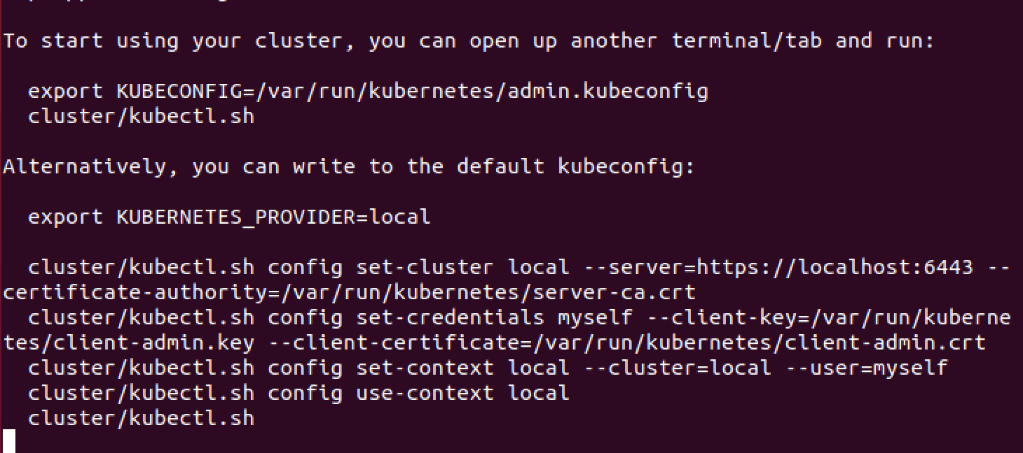
Building K8s From Source - 5
Start the cluster:
hack/local-up-cluster.sh

Slide 7
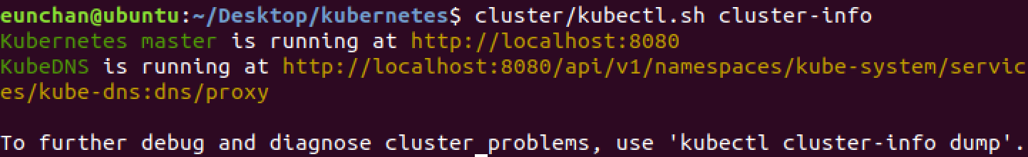
Building K8s From Source - 6
In a new shell, in the kubernetes directory:
cluster/kubectl.sh cluster-info

